Slide 1

AI-Powered Software Requirements Analysis
and Validation System
Under the guidance
Of
Swapna Reddy
Batch No: 06
Team Members:
Pathi Sharmila-2420030042
Lakshman Angara-2420030067
Sanivarapu Sadhana - 2420030225
Vishnu Priya Kodali-2420030630

Slide 2
Problem Statement
Software projects often experience failures and delays due to unclear, incomplete, inconsistent, or misunderstood requirements during the early stages of development. Existing requirement management approaches mainly rely on manual reviews, which are time-consuming and may not identify requirement issues effectively at an early stage. These problems can result in rework, communication gaps, project delays, increased development costs, and poor software quality. Therefore, there is a need for an intelligent and automated approach that can analyze requirements, detect issues such as ambiguity, inconsistency, incompleteness, and duplication, and provide useful suggestions to improve requirement quality before development begins.

Slide 3
Objectives
To analyze software requirements using AI to identify potential issues at an early stage.
To detect ambiguous, incomplete, duplicate, and conflicting requirements automatically.
To improve unclear or poorly defined requirements using AI-generated suggestions.
To assess requirement quality and identify potential risks that may affect software development.
To generate structured user stories and acceptance criteria automatically from analyzed requirements.
To provide an interactive and user-friendly dashboard for visualizing requirement issues, quality scores, risks, and analysis results.

Slide 4
Existing Systems
Current Method:
Requirements are mainly reviewed manually.
SRS documents are checked by developers, analysts, or testers.
Requirement quality depends heavily on human expertise.
Issues may be discovered during later development stages.
Limitations:
Time-consuming manual analysis.
Difficult to identify all ambiguities and inconsistencies.
Higher possibility of human error.
Late detection can increase development effort.
Limited intelligent assistance.

Slide 5
Proposed System
Spec Mind AI uses Generative AI to analyze software requirements at an early stage.
The system can:
Accept requirements through text or SRS documents.
Analyze requirement quality using AI.
Identify ambiguity, incompleteness, duplication, and conflicts.
Suggest improved requirements.
Generate user stories and acceptance criteria.
Provide requirement quality and risk insights.
Benefit: Problems can be identified and corrected before actual software development begins.

Slide 6
Technology Used
Python – Used for the core application logic, requirement analysis, and processing.
Flask – Provides the backend framework and connects the user interface with the analysis modules.
HTML5 & CSS3 – Used to structure and design the web interface.
Bootstrap 5 – Provides responsive and user-friendly UI components.
Google Gemini API – Used for AI-based requirement analysis, issue identification, explanations, and improvement suggestions.
MySQL – Stores requirements, analysis results, and project-related data.
PyMuPDF – Extracts and processes text from requirement documents in PDF format.
Chart.js – Displays requirement analysis results and insights through interactive charts.
Git & GitHub – Used for version control, collaboration, and maintaining the project source code.

Slide 7
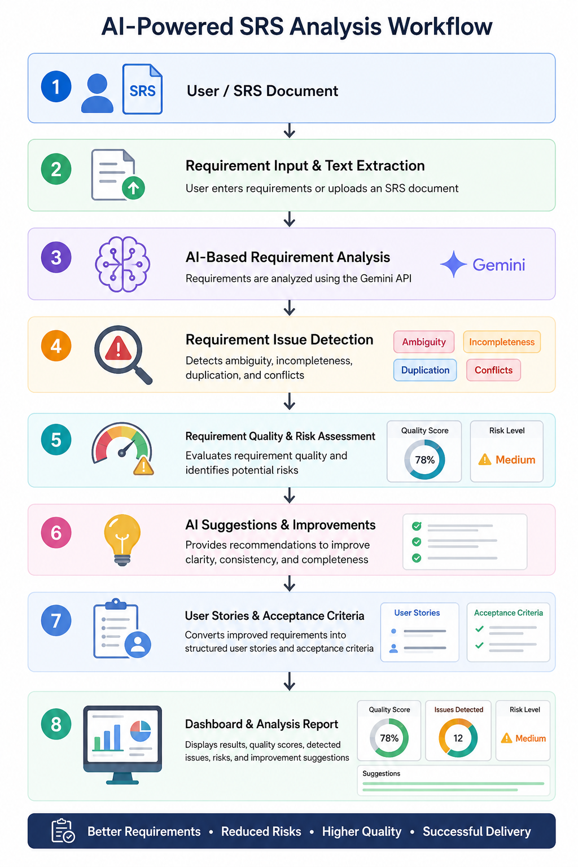
Workflow

Slide 8
Modules
Requirement Input Module
SRS Document Processing Module
AI Requirement Analysis Module
Requirement Validation Module
Risk & Quality Assessment Module
User Story & Acceptance Criteria Generation Module
Dashboard & Report Module

Slide 9
Conclusion & Future Scope
Conclusion
SpecMind AI provides an AI-assisted approach to software requirements analysis by identifying requirement issues and providing intelligent improvement suggestions. The current implementation establishes the foundation for automated requirement validation and analysis.
Future Scope
Automated requirement traceability.
AI-based test case generation.
Advanced requirement risk prediction.
Jira/GitHub project integration.
Automatic SRS generation.
UML diagram generation from requirements.
Multi-language requirement analysis.

Slide 10
Thank You

